Slide 1

KNOXVILLE_R_USERS_GROUP

Slide 2

A Data Cleanup Experience in R
B. Crombie
Notes:
I received a disc of data through the “Freedom of Information Act” from our government contractor a couple of weeks ago. I couldn’t open it because it was encrypted and they hadn’t sent me instructions, so I was already irritated. So, I dug into my archives from a year ago when they’d sent me a similar set of data and a “one-time” decryption password in the same email, and it ended up working with this disc too!

Slide 3
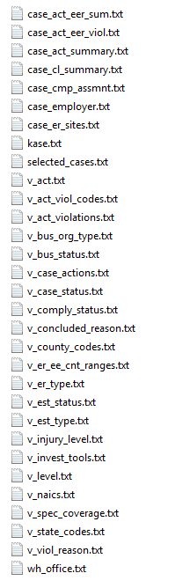
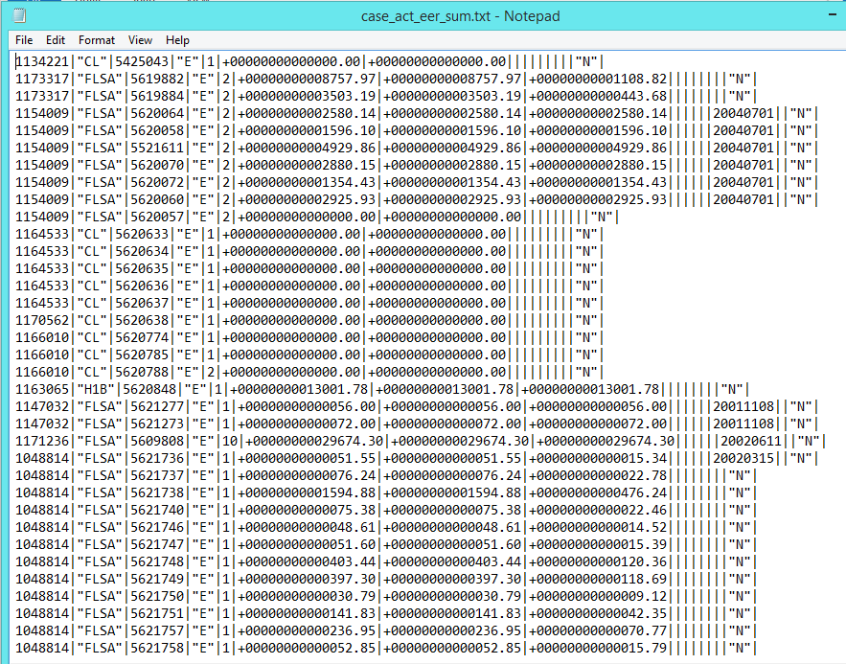
Receive Data
31 pipe-delimited text files – contents undefined
Notes:
The data consisted of about 30 text files without variable labels, so I looked further and…

Slide 4
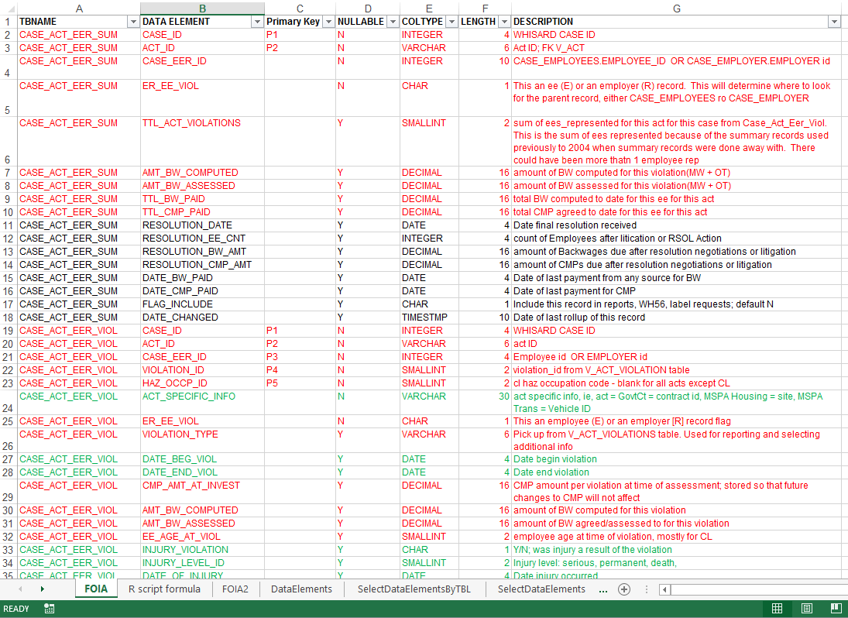
Receive Separate Data Dictionary
336 text file elements will be defined using supplemental Excel data
Notes:
…found an Excel file on the disc that was the dictionary for the 300-something data elements. I knew the dataset was from a relational database, so I figured I’d just configure it in Microsoft Access and extract what I needed before analyzing it in R. Well, the text files wouldn’t import to Access correctly and that made me even more irritated, so I decided to quit being a baby about it and just go ahead and use R to do something with the information, because my Access subset was going to end up in R anyway.

Slide 5
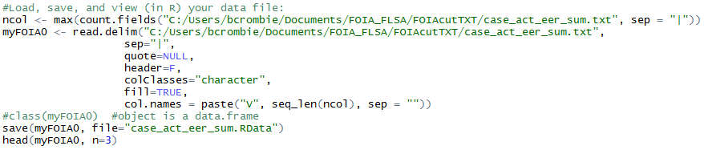
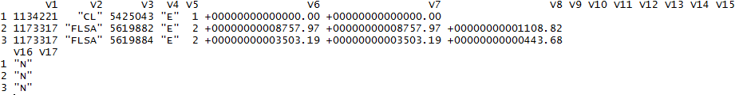
Load Data into R
Notes:
The data from the first file looked like this and I knew I had to at least get rid of the plus signs in the currency variables and probably lose the quotation marks, too.

Slide 6


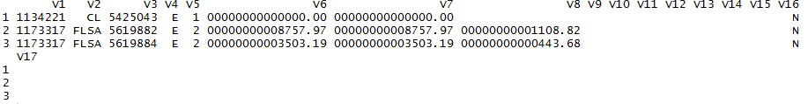
Clean up Data in R
BEFORE
AFTER
Notes:
So my “angels-singing” moment that I wanted to share with other beginners in the group today is this simple function I discovered that will get rid of every character I don’t want in a string except for alphanumeric characters and anything else I might want to keep – in this case the decimal point for the currency variables. This improved my mood a lot, although I was still a little concerned about the leading zeros in the number strings.

Slide 7
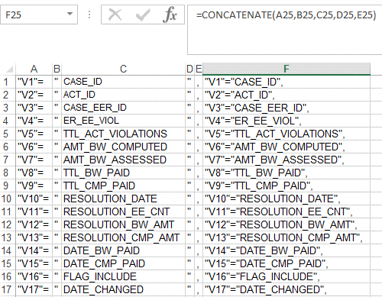
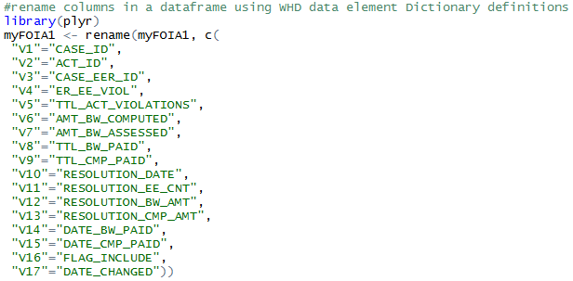
Define Data in R
copy/paste concatenated column name string from Excel dictionary to R script
Notes:
Since my data was already in R, I went ahead and renamed the variables more specifically, and decided I’d draft a table in my Excel dictionary that would concatenate the components of the strings for my R script so I could just cut and paste the column names. And it went quickly after that.

Slide 8
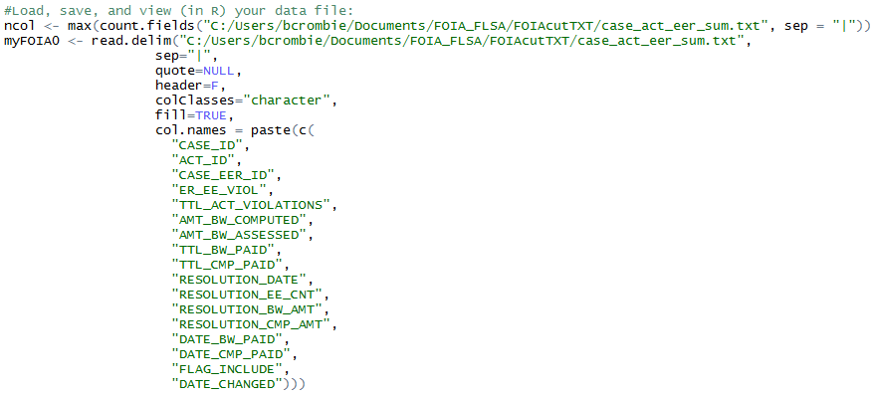

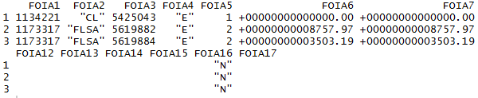
Define Data in R – sooner
Could label columns when data loaded into R, but not sure if I’ll need to mess around with script and don’t want long column names to deal with..
Notes:
And then I got to thinking that to speed up the R script, I guess I could have given the columns their specific names when I read the data into R in the first place, but at this point, I was able to import the text files smoothly into Access.

Slide 9
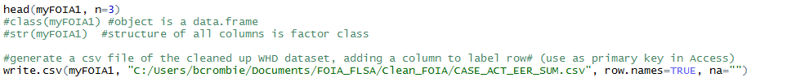
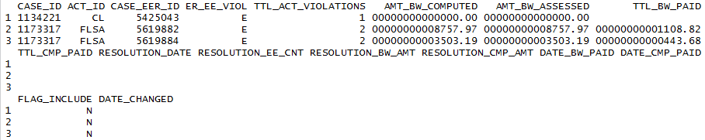
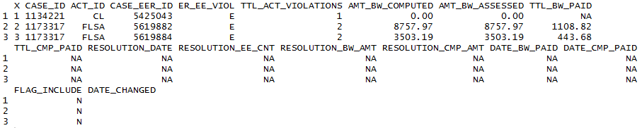
Save R output as .csv for MS Access queries, then read subset back into R
.csv for Access
.csv loaded back into R to test R translation
Notes:
And as far as those leading zeros in my number strings, I hoped that R would automatically translate them later to a number format that I wanted, and it did, which ended the experience on a good note. So, with that I’ll hand the podium over to our next presenter who will share suggestions for customizing functions like the one I just mentioned and some more tips and tricks for R users.

